Slide 1
Wine Recommender System
Final Presentation
Team Name: G8 - SAFW
Team Members: Shane Nelson, Allie Schneider, Francis Villamater, Will Wu

Slide 2

Project Description
Build a wine recommender system
Wine discovery
Guidance and education
Grape varieties, regions, and prices

Slide 3
Goals
Create a system to allow users to discover more wine
System should be applicable to a wide range of users
From novice wine consumers to wine sommeliers
Recommendations should be relevant and applicable to the user

Slide 4
Benefits of Project
Potential to expand the wine market and increase wine sales
Yields a tool for improved inventory management
Generates an enhanced customer satisfaction
Creates for a more manageable process of discovering and learning about wine
Provides personalized wine recommendations
Benefits both wine novices and wine sommeliers

Slide 5
Potential Stakeholders
Novice Wine Consumers
Cultivate a better understanding of the user’s palate for wine
The system can aid in finding new wines to enjoy
Offers insights into different grape varieties, regions, and styles
Provide guidance and education that will help in understanding the complexities of wine
Wine Sommeliers
The system can be used to expand the breadth of the user’s experiences
Serve as a valuable tool for discovering new and obscure wines
Expand the user’s knowledge beyond the existing repertoire
Bring to light different perspectives and suggestions

Slide 6
Functionality: Content-based
Input
Output
User reviews taken as input with wine characteristics extracted and used to fit ML model
(Location of Origin, Variety, Price, Rating)
System would predict user rating for all other un-reviewed wines in the database to estimate a review score and provide recommendations
Notes:
User will provide characteristics of wine that they like (i.e. color or flavor, etc.)
A knowledge-based recommendation using item features from the dataset
System will provide relative items based on item features & user input
Database could be expanded and provide estimated scores for it’s users
A content-based recommendation that leverages the wine reviews column to predict the user ratings of new wines from wines with similar qualities
User can provide an exact wine (vintage, winery, variety, etc.)

Slide 7
Functionality: Knowledge-based
Input
Output
User provides characteristics of wine that they prefer:
Wine variety, vintage, flavor characteristics, etc.
System would provide relevant items (wines) based on the various wine features, ranked by average user rating.
Notes:
User will provide characteristics of wine that they like (i.e. color or flavor, etc.)
A knowledge-based recommendation using item features from the dataset
System will provide relative items based on item features & user input
Database could be expanded and provide estimated scores for it’s users
A content-based recommendation that leverages the wine reviews column to predict the user ratings of new wines from wines with similar qualities
User can provide an exact wine (vintage, winery, variety, etc.)

Slide 8
Functionality: Case-based
Input
Output
User could input a specific, preferred wine title. System would automatically extract wine attributes and calculate cosine similarity with other wines in database
System would provide similar wines with characteristics which match the wine entered by the user.
Notes:
User will provide characteristics of wine that they like (i.e. color or flavor, etc.)
A knowledge-based recommendation using item features from the dataset
System will provide relative items based on item features & user input
Database could be expanded and provide estimated scores for it’s users
A content-based recommendation that leverages the wine reviews column to predict the user ratings of new wines from wines with similar qualities
User can provide an exact wine (vintage, winery, variety, etc.)

Slide 9

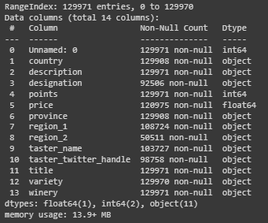
Dataset
120,000 unique wine reviews collected from WineEnthusiast (winemag.com)
Over 100,000 unique wines
14 attributes:
Country, Description, Designation, Points, Price, Province, Region_1, Region_2, Taster_Name, Taster_Twitter_Handle, Title, Variety, Winery
Only 19 specified reviewers (20% nulls/not specified)
Attributes of Interest for Modeling: Country, Province, Description, Points (rating), Price, Variety

Slide 10
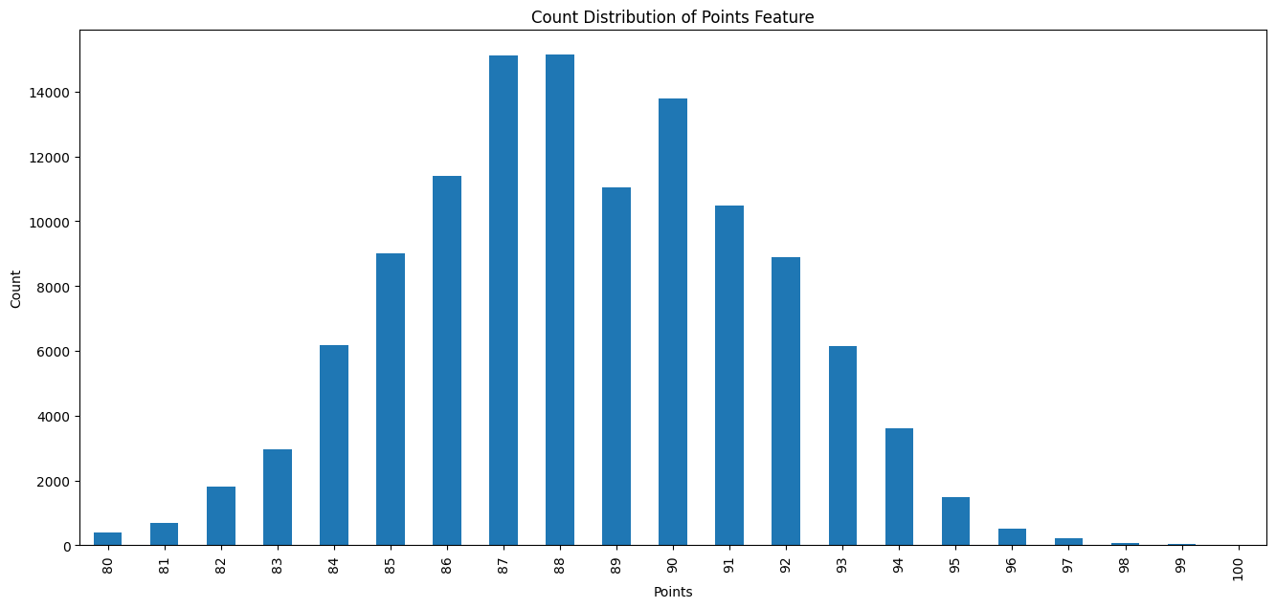
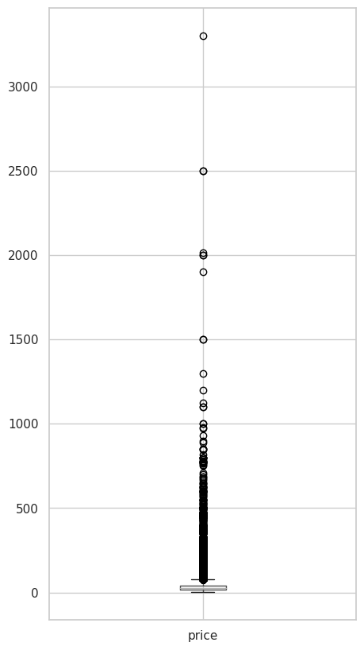
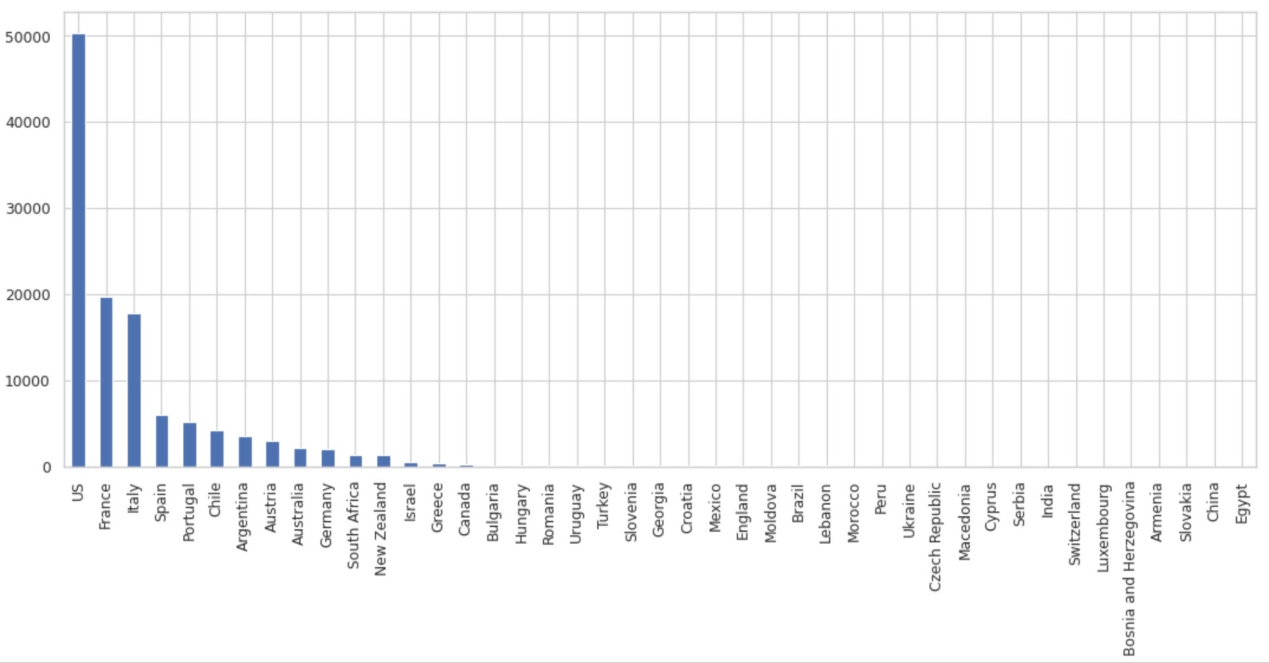
EDA
Points attribute – Relatively Normal Distribution with weird scale
Price attribute – Heavy right skew, applying a logarithmic transformation
Created new ‘location’ attribute to balance country feature (initially dominated by US)

Slide 11
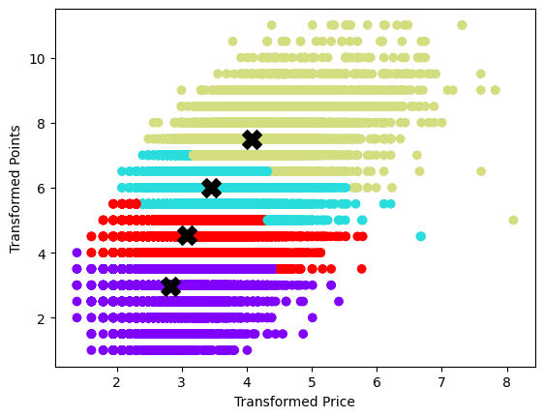
Clustering Model
KMeans Clustering
Uses Transformed Points and Transformed Price attributes.
4 clusters
Features were limited to these two variables since KMeans largely operates with numeric variables
Avoid high dimensionality, computational complexity
Balance between defined clusters and number of clusters, and legibility
Clusters became much less defined with additional variables (e.g. one-hot encoded categorical)

Slide 12
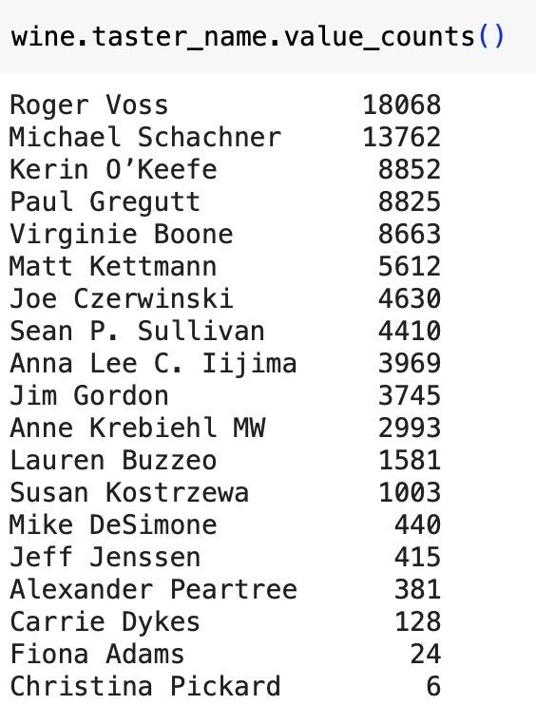
Classification Overview
Encode ratings 1 or 0 (1 is rating >= 88; 0 is rating < 88)
Filter for target user -> ‘Roger Voss’
X (input) = Variety (one-hot encoded), Location (one-hot encoded), Price (log transformed)
y (target) = Yes/No Recommendation (1/0)
Train and test 4 different models and compare results
Logistic Regression
Decision Tree Classifier
Random Forest Classifier
K-Nearest Neighbors

Slide 13
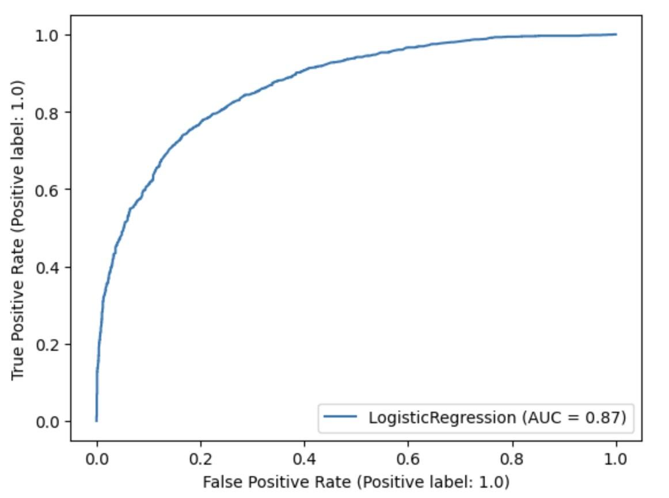
Logistic Regression - Best Model
Best performing classification model
No hyperparameter tuning
Accuracy: 0.79
Precision: 0.79
Fewest false positives
 | Predicted Positive | Predicted Negative
True Positive | 1535 | 318
True Negative | 413 | 1231

Slide 14
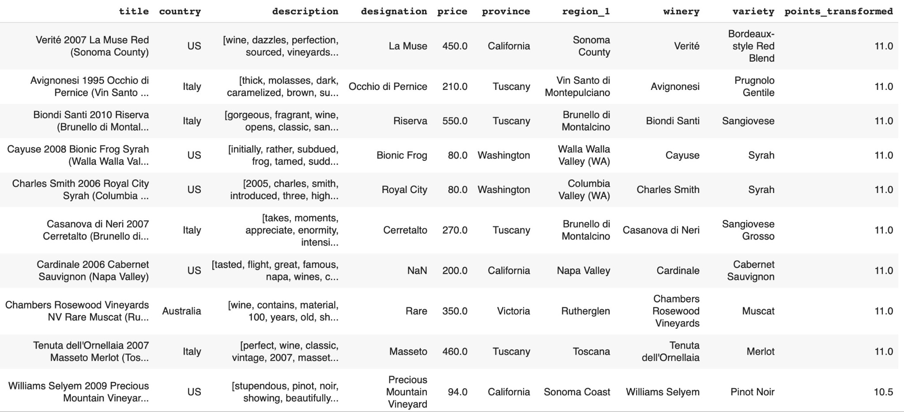
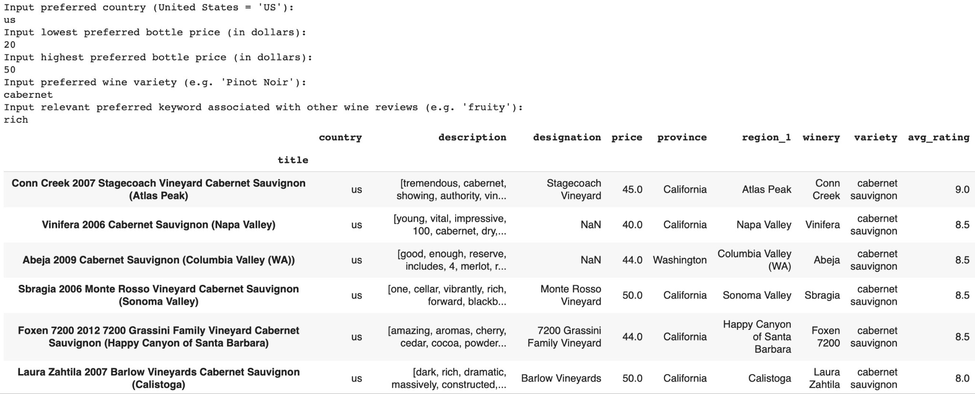
Real-World Example - Classification
Top 10 Un-Reviewed Wines
Ranked by average user points rating
54,101 recommended wines -> constraint based filtering should be added
Example of Added Constraint-Based Filtering

Slide 15
Regression Overview (Content-Based Recommender)
Similar to aforementioned classification modeling, except a predicted numeric rating would be made for all wines instead of just a Yes/No recommendation
Train/Test models with the same input content variables (price, variety, location) to predict numeric target feature
‘Real-world’ application is that the best model would be fit with all of a user’s reviews
Numeric predictions made for all un-reviewed wines in database
Recommendations provided based on highest predicted rating by model
For example, provide 10 recommendations ranked by highest predicted rating

Slide 16
Regression Steps
Filter for target user -> ‘Roger Voss’
X (input) = Variety (one-hot encoded), Location (one-hot encoded), Price (log transformed)
y (target) = Numeric Points Rating
80/20 Train/Test for Roger’s 18,068 reviews
Use same train and test sets for 3 different regression models to compare results

Slide 17
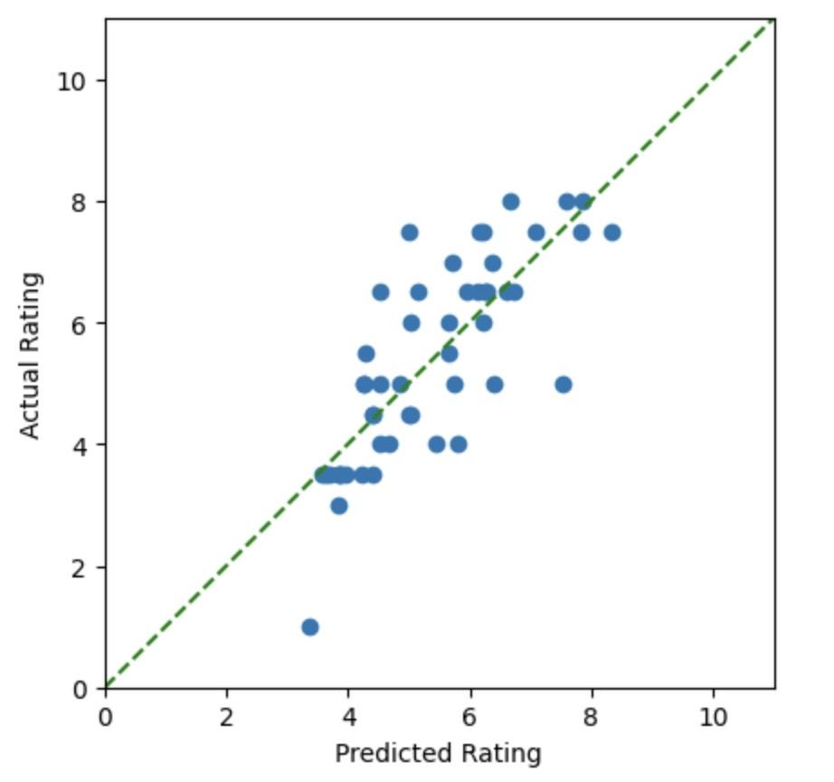
Random Forest Regressor - Best Model
Hyperparameter Tuning:
N_estimators: 200
Max_Depth: 25
Min_Samples_Split: 75
R-Squared = 0.60
RMSE = 0.98
Actual vs. Predicted Rating (50 wines)

Slide 18
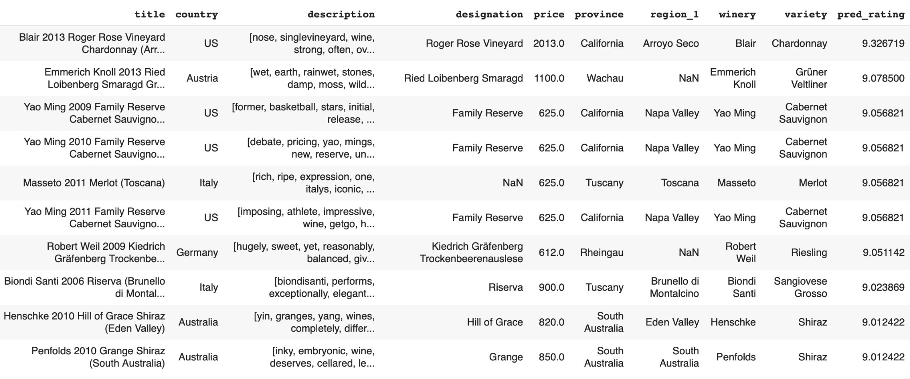
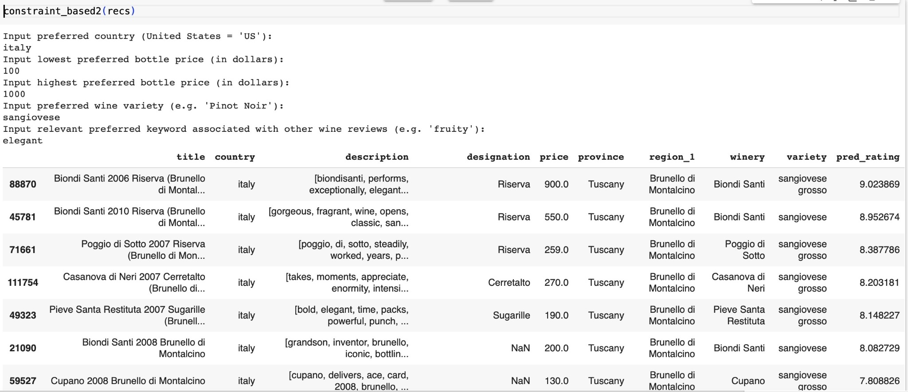
Real-World Example - Regression
Top 10 Predicted Un-Reviewed Wines
Common Theme -> System highly ranks expensive wines
92,552 predicted ratings to sort through (too many) -> constraint based filtering helps narrow results
Example of Constraint-Based Filtering for Predicted Ratings

Slide 19
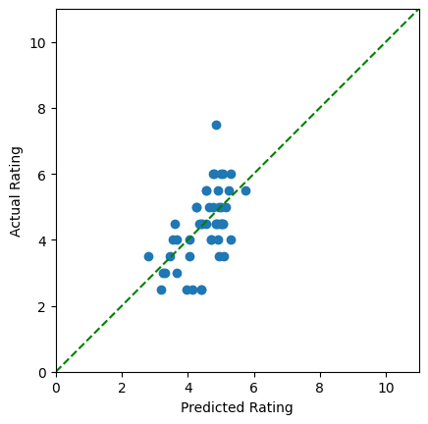
Cosine Similarity (1 of 2)
Actual vs. Predicted Rating (50 wines)
Calculates cosine similarity between two vectors in a 3D space
Uses Price, Variety, Country, and Province
Prediction will only use the rating from the closest specified neighbor wines, returning the average of the neighbor wines ratings
Similar to regression/classification, predictions are user-specific
RMSE = 0.90

Slide 20
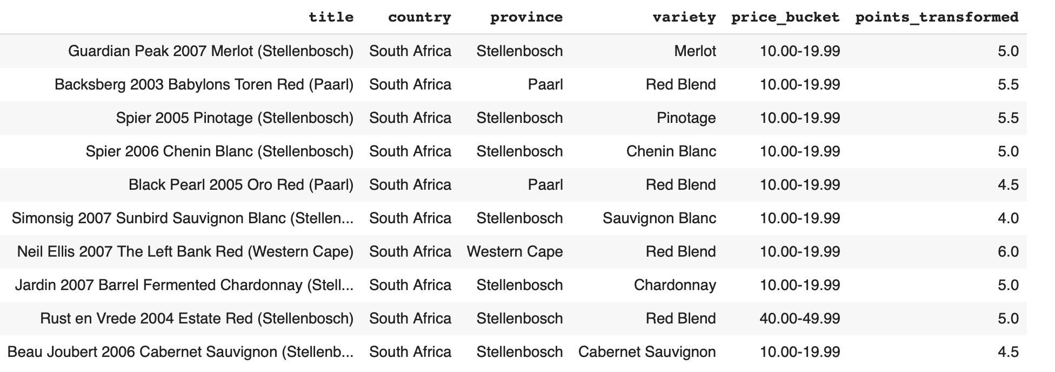
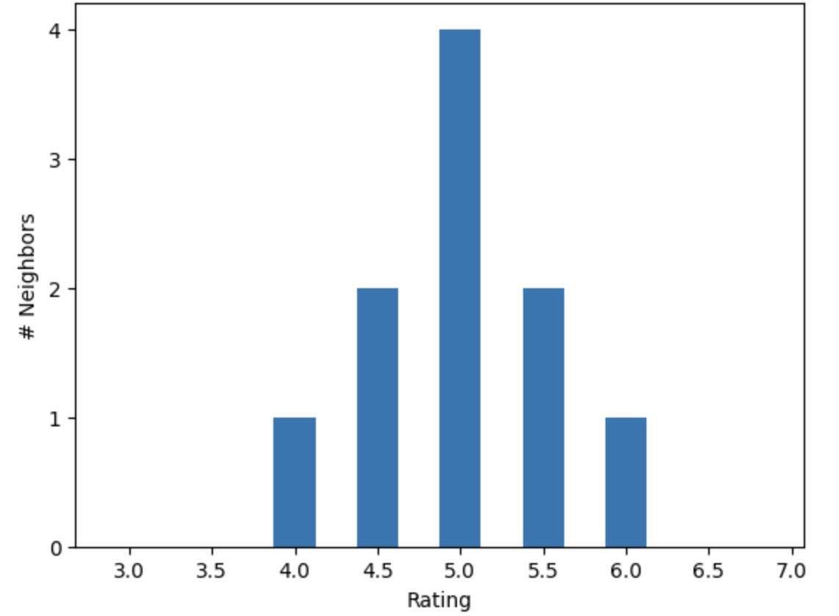
Cosine Similarity (2 of 2)
Characteristics of target wine:
Neighbors:
Distribution of Neighbor Ratings
Actual User Rating = 5.0
Predicted User Rating = 5.0

Slide 21
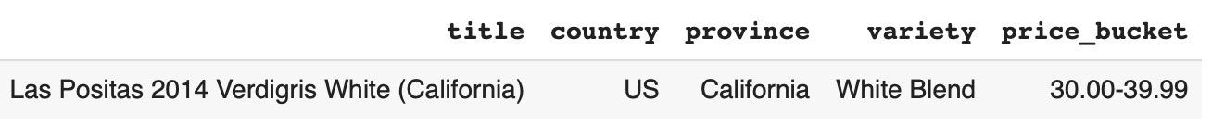
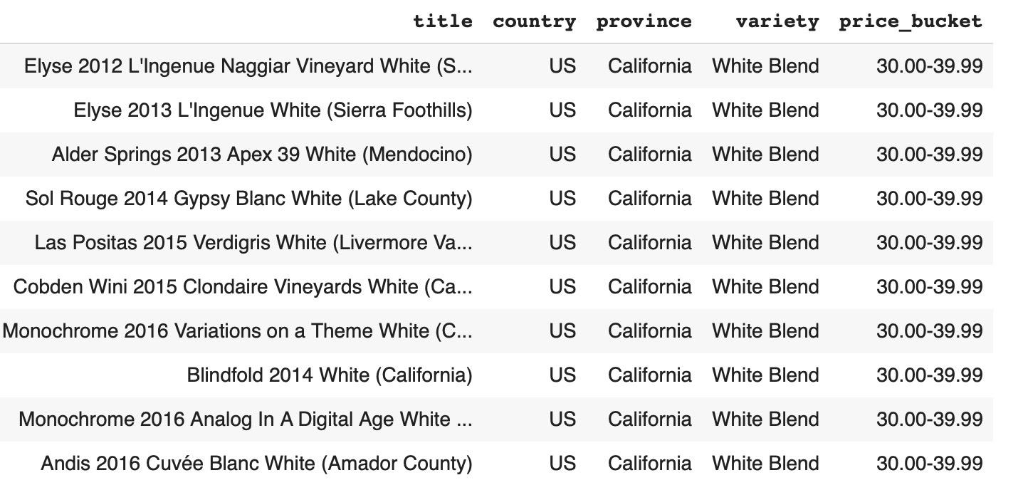
Case-Based
Also uses cosine similarity, but does not consider reviewer names and ratings
Takes input wine:
Outputs related wines:

Slide 22
Limitations
Limited number of unique users prevents the implementation of a collaborative filtering system
Limited Coverage - will not include or reflect more contemporary preferences, trends, or shifts in methods of production within the industry
Recommender systems benefit from more input data, incorporating other datasets with socio-economic, cultural, or even regional attributes could possibly yield better performance
Certain fields in raw data are unusable:
Designation is not standardized (i.e. ‘reserve’ and ‘riserva’)
Winery has too many unique values to be used in any model (dataframe or vector would become too large after one hot encoding)

Slide 23
Summary of Results
Cosine similarity provided best overall accuracy predicting user ratings during testing
Content-based system created for more experienced users with extensive review history:
Models perform better for users with greater number of reviews for training
Cosine similarity and random forest regressor each predicted user ratings within a point of the actual rating
Logistic regression made correct predictions of whether or not a user would enjoy a wine 79% of the time, and 79% of recommended wines were actually enjoyed by user
Knowledge-based system and case-based system more applicable for new users with little to zero review history

Slide 24
References
Data source: https://www.kaggle.com/datasets/zynicide/wine-reviews
Github Repository: https://github.com/snelson97/DSCI591_G8SAFW

Slide 25
Thank You

